Slide 1

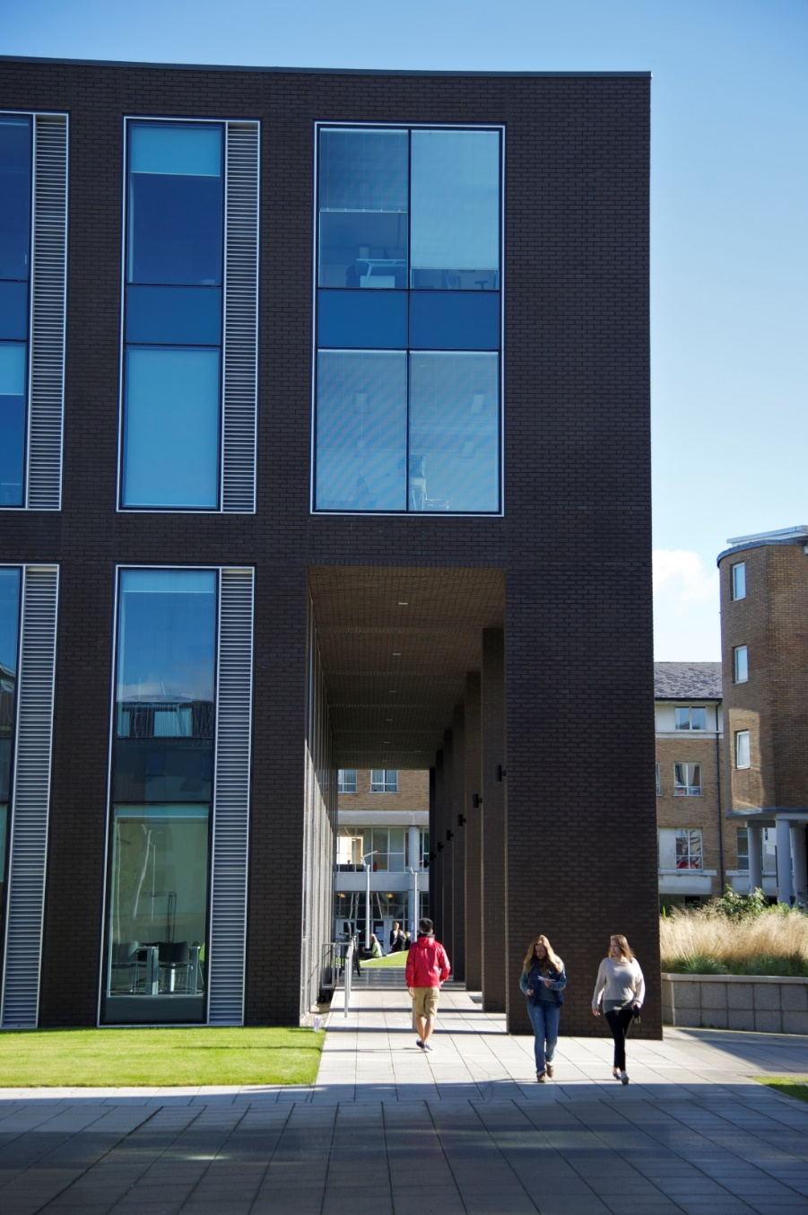

Lancaster University Management School
NOTE: IMAGE TO GO HERE
Mathew Pitts
International Partnerships Officer
Global Experiences & Partnerships Team
exchangelums@Lancaster.ac.uk

Slide 2
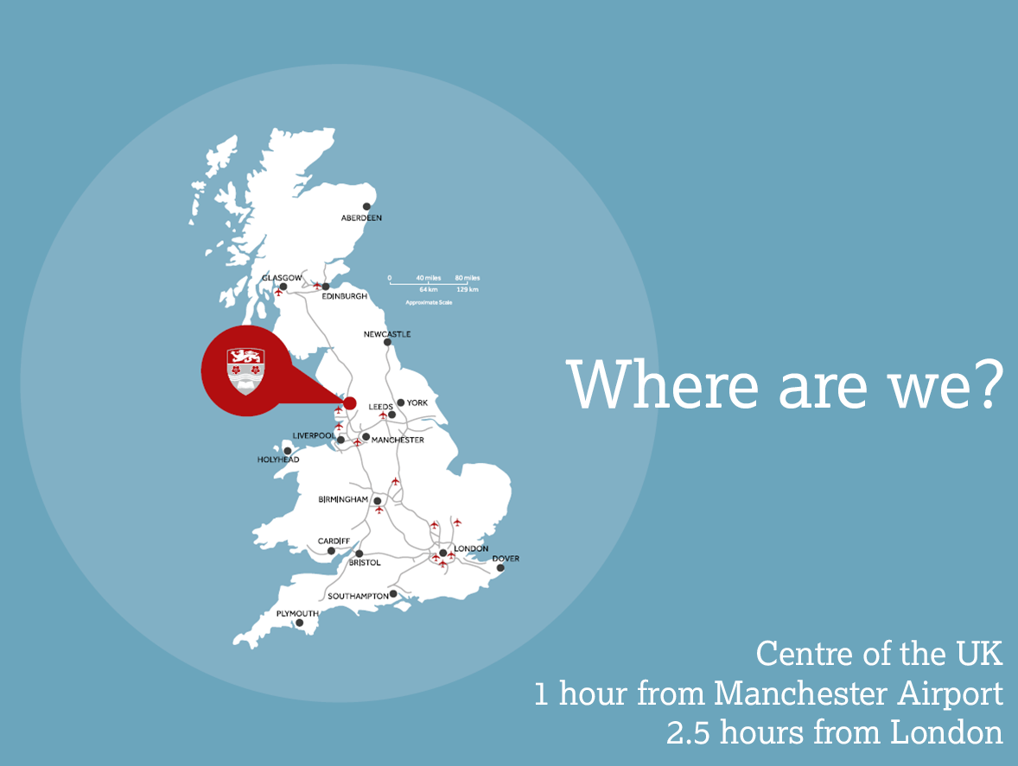
NOTE: IMAGE TO GO HERE

Slide 3
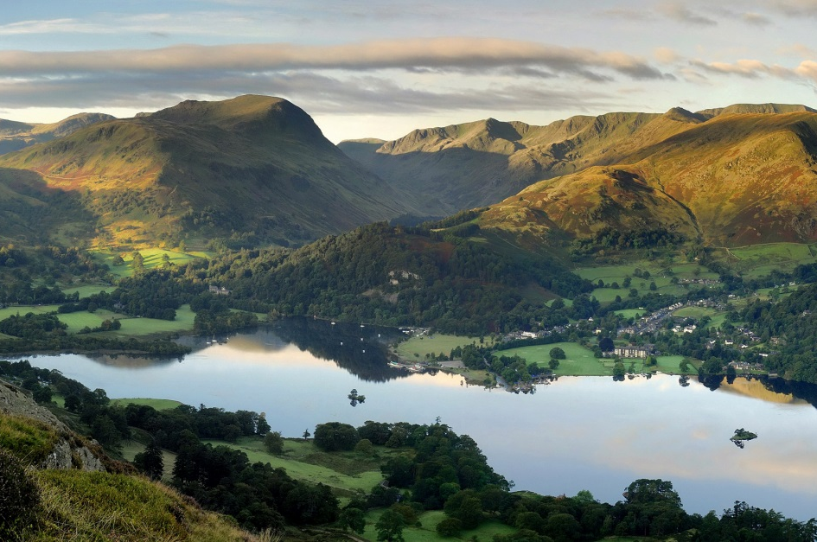
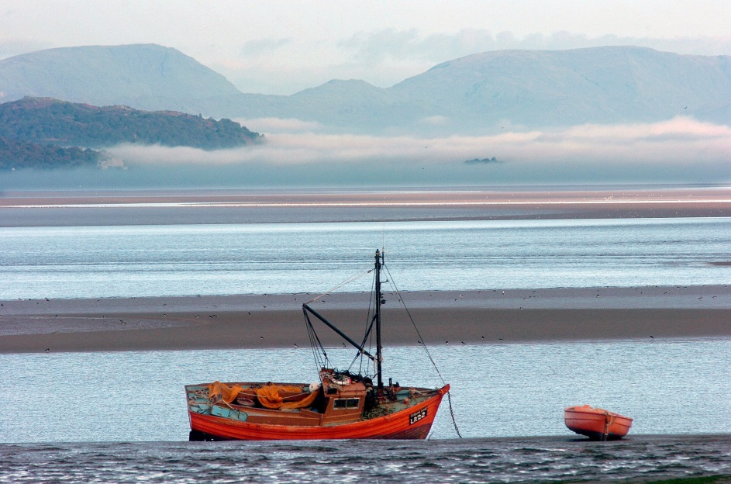
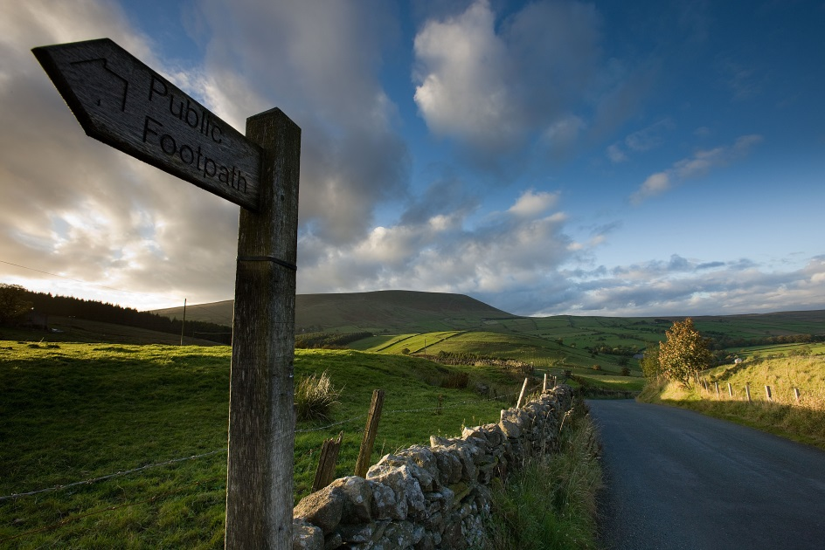
The City of Lancaster is set between Morecambe Bay and the picturesque Pendle Hills (right).
We are only 30 minutes from the Lake District National Park (top).

Slide 4
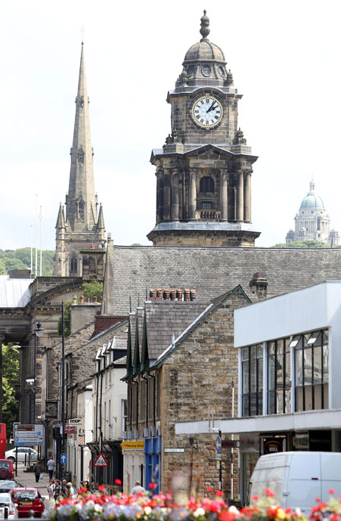
Lancaster
Historic
Dating back to the 12th century
With character
Theatres, museums, galleries, Williamson Park
Cosy and safe
144k inhabitants
Well connected
Rail links to major cities & Manchester Airport
Student city
One tenth of the population are students!
Notes:
Worth mentioning that the cost of living in Lancaster is generally cheaper than most other cities- I’ll cover this in more detail later!

Slide 5
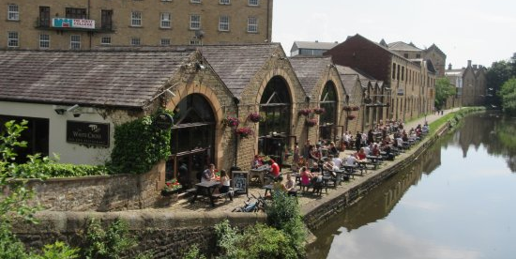
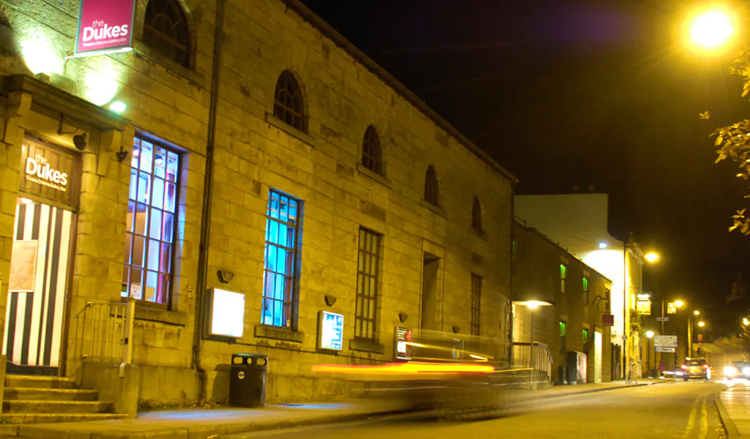
Lancaster
NOTE: IMAGE TO GO HERE
Notes:
A few of my favourite things in Lancaster. Clockwise top left: Atkinson’s coffee shop; the White Cross on the canal; The Dukes independent cinema & theatre; Ashton memorial in Williamson Park.

Slide 6

Lancaster University
An outstanding education, based on world leading research and delivering in an enjoyable and supportive learning environment
Notes:
Founded in 1964.
13,700 students- 70% UG, 30% PG
Bachelors, Masters and PhD programmes. Taught and research Masters.
280 undergraduate programmes
222 postgraduate taught programmes

Slide 7
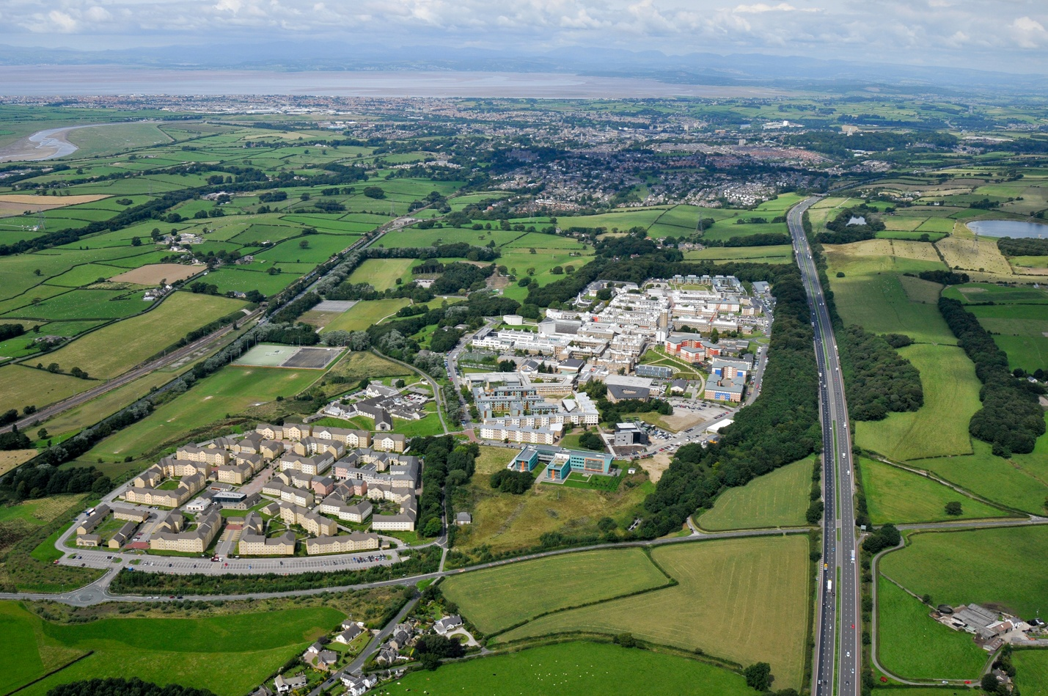
Our Campus
Notes:
560 acre campus. Fifteen minute bus journey from the centre of town. My commute is 20 minutes- leave the house at 7.55 and be in work at 8.15!
Morecambe Bay, south Lake District at the top.

Slide 8



Research and teaching
World-leading research
83% of research activity is world-leading or internationally excellent. It is the only one of the eight most research intensive universities in the North of England to have had research funding increased.
7th for Teaching Excellence in Europe
Lancaster University is among the best universities for teaching excellence in the Times Higher Education Europe Teaching Rankings 2019.

Slide 9
Lancaster University
Lancaster University Management School
Faculty of Arts & Social Sciences
NOTE: IMAGE TO GO HERE
Faculty of Science & Technology
Faculty of Health & Medicine
Notes:
Four faculties- obviously, we’re most interested in the top left, but you’ll be in a community of students across departments. We’re not just a management school! Visit seminars, research symposia, etc.

Slide 10
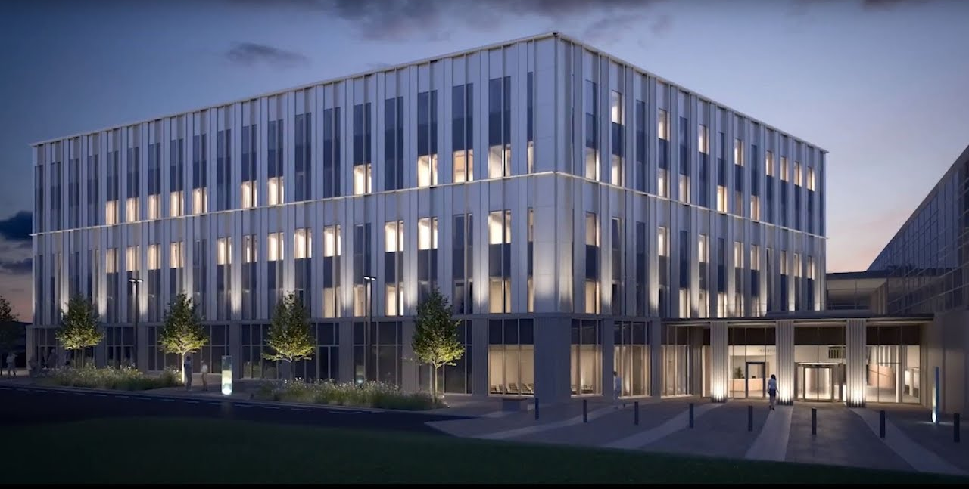
Lancaster University Management School
NOTE: IMAGE TO GO HERE

Slide 11
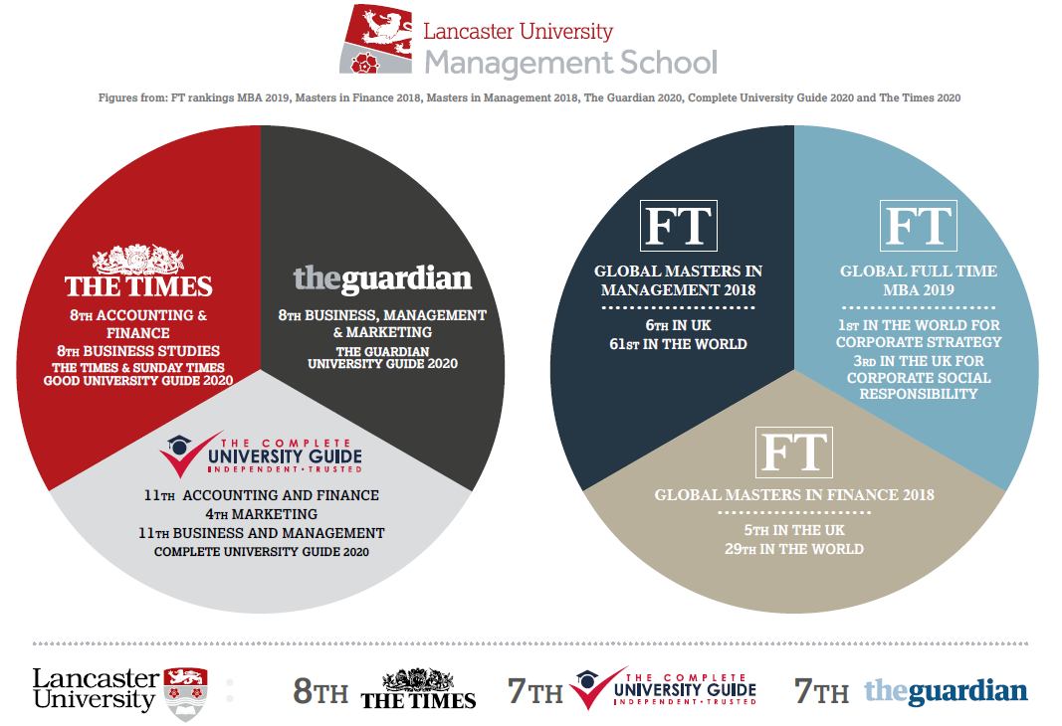
Notes:
League tables can't tell you everything about a university, but they're a good place to start. Out of over 120 UK Universities, we are consistently in the top ten and are ranked 8th overall in the Good University Guide 2020
Lancaster was also been named University of the Year by The Times and The Sunday Times Good University Guide 2018. It has also taken the top spot for Best Campus University and Best University in the North West. “In the 19 years of our University of the Year awards, there has rarely been a more clear-cut winner.”
Times International University of the Year 2020- Few universities can match Lancaster's record for exporting British higher education to the world, while at the same time offering opportunities to their UK-based students to incorporate a global learning experience within their degree programmes. Our International University of the Year award is designed to recognise both achievements and Lancaster stood out in a crowded marketplace.”
NSS results- consistently good performance, which also puts us in the top ten of non-specialist universities.
We have won awards for our facilities. For example, best university accommodation which I will talk about a little later.
QS World University Rankings 2019 placed us in the top 100 for Accounting and Finance, Business and Management and Statistics and Operational Research.
The Lancaster MBA was ranked 1st in the world for corporate strategy and 10th in the world for value for money. Financial Times 2018 Top Global Full-time MBA Programmes
Our MSc in Finance was ranked 5th in the UK and 29th in the world in the Financial Times Global Masters rankings

Slide 12




A mark of quality
International outlook
NOTE: IMAGE TO GO HERE
Collaboration partners
Student support
Notes:
AACSB - The leading American business school accreditation body, becoming global in its reach, which has accredited all of the USA's top business schools such as Harvard, Stanford and Wharton among others.
EQUIS - The leading European business school accreditation kitemark, managed by the European Foundation for Management Development (EFMD). The key focus includes internationalisation and strong organisational relationships.
AMBA - The association of MBAs, although UK-based in its origins, is the only accreditation body to focus on MBA programmes around the world. Our MBA, Executive MBA and MSc Management are all AMBA accredited.
Small business charter - The SBC is an award for the UK’s world-class business schools, celebrating those that play an effective role in supporting small businesses, local economies and student entrepreneurship and the impact they make.

Slide 13
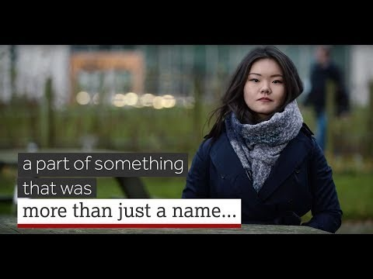
The place to be
Notes:
I’m actually in this video- see if you can spot me!
https://www.youtube.com/watch?v=iw0ytxfFjzw

Slide 14








Careers
“Graduate prospects are the best for any non-specialist university in the UK with employers falling over themselves to recruit Lancaster students.”
Alistair McCall, editor of The Times and Sunday 2019
Integrated careers workshops across all programmes
Employer events, conferences and visits
Links to international employers
Regular drop-in clinics and workshops
Notes:
Entrepreneurs in residence scheme- link up with local entrepreneurs.
Every student has access to a specialist Business Management Careers Coach and attends sessions on CVs and teamwork.
Lancaster University is 3rd in the UK for employment prospects – The Times and Sunday Times 2019.
Multiple award-winning: won the Abintegro 2019 overall award for developing digital employability skills, recognising the work undertaken by the Careers Team in developing bespoke digital employability resources.

Slide 15
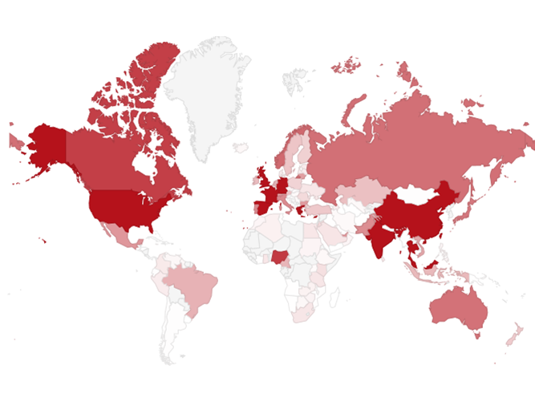
Alumni
Over 43,000 alumni in 164 countries.
Alumni profiles written by our graduates about their time at LUMS and subsequent careers
Network of LUMS Alumni (informal advice based on their own Lancaster experiences)
Guest speaker events (industry experts, careers)
Networking
Project and placement opportunities
Career mentoring and advice

Slide 16
LUMS Learning Development
Our Learning Development team have regular drop-in sessions, longer courses and workshops on academic skills for undergraduate study:
  Essay writing support- academic writing zone gives one-to-one advice
  Maths and Stats Help (MaSH) for drop-in sessions, specific workshops or tailored support plans

Slide 17

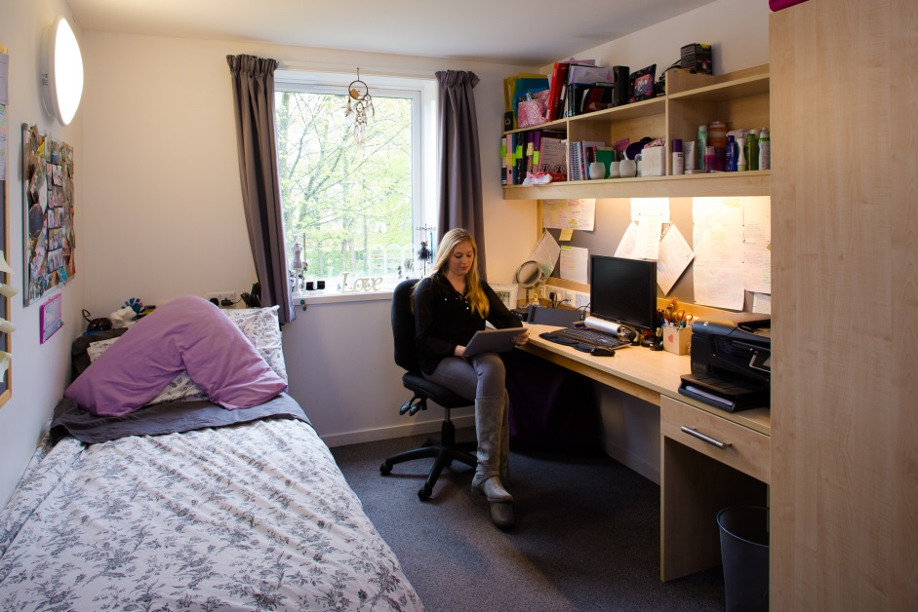
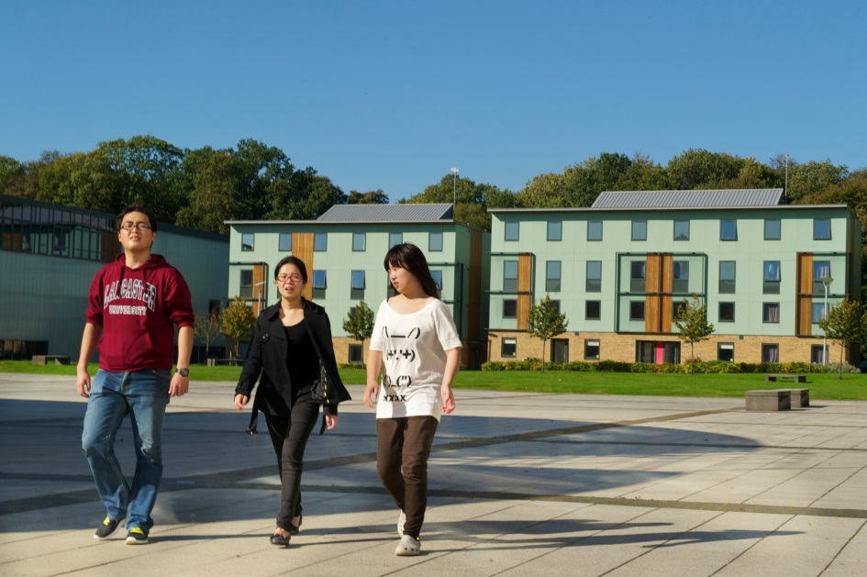
Self-catering or catered accommodation available
National Student Housing Awards 2019: Winner (Best University Halls)
Safe and secure environment
Low cost: From £107.03pw
Accommodation
Notes:
Lancaster has a collegiate system. All students are members of a college- a kind of university within the university. Regular events, coffee mornings, etc.

Slide 18
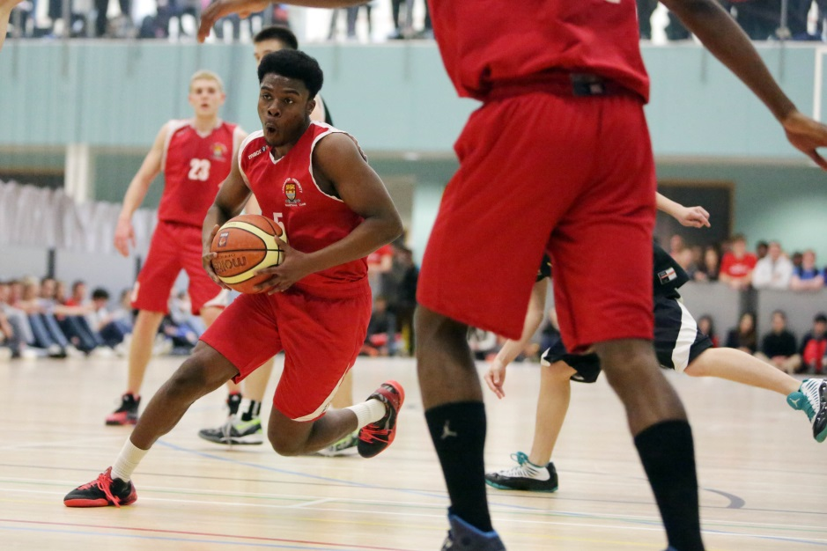
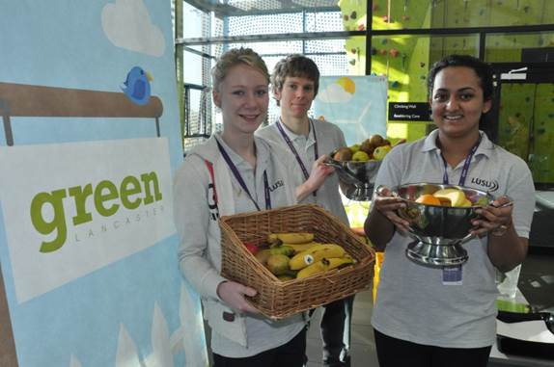

Headline
To Go Here
Our Students’ Union has more than 175 clubs and societies on offer, a highly qualified welfare and advice centre, and a nationally-respected volunteering unit.

Slide 19










Student societies
Notes:
Management School-specific/careers focused societies: Advertising Society, Finance society, Consulting.
Wide range of sports related societies, covering pretty much every sport you can name- from archery to yoga! We also have a dedicated Harry Potter Society, and I’ve included something close to my heart- student radio!

Slide 20
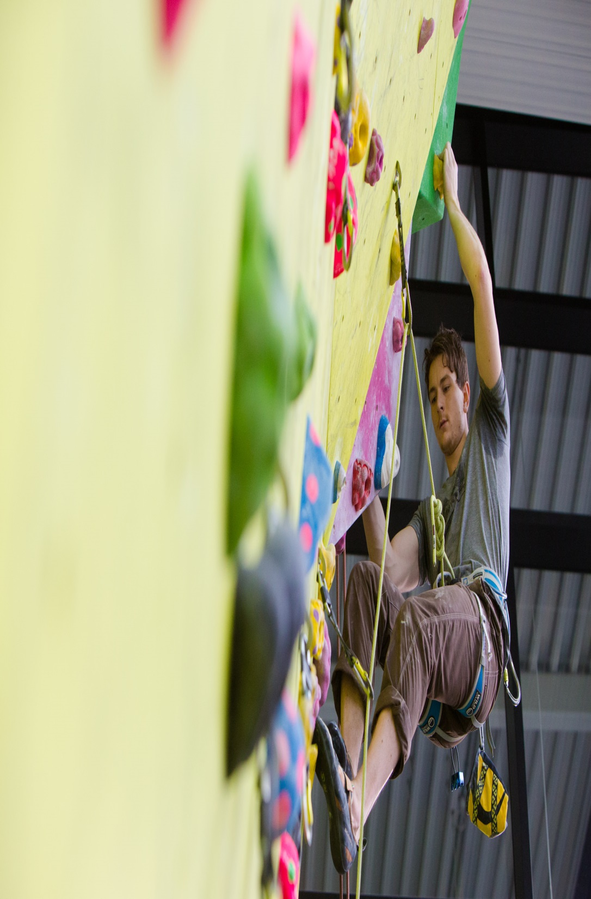
Facilities
Sports Centre with 25m swimming pool, climbing wall, sports hall, playing fields, sports courts, and 100-station gym
Multi-faith Chaplaincy Centre, Prayer Rooms, Health Centre, Dentist, Pharmacy, and Pre-School Centre
Theatre, cinema and art gallery
Post Office, banks, supermarkets, bookshop, hairdresser, plus many restaurants, cafés and bars
Notes:
Sports Centre is currently having an extension built- 1347m². Due to complete spring 2020. Adds basketball court, eight badminton courts.
My favourite restaurant- Sultan’s. Amazing curry, and also great halloumi wraps. Best place on campus for coffee is Pizzetta- it’s a pizza restaurant that has amazing coffee!

Slide 21
Double degree at LUMS
You will join the BSc Business Management degree in Year 2.
Business Management is a consortial degree. This means it takes in modules across the Management School.
Study core modules in both years: Employability and Careers; Entrepreneurship; Operations Management; Leadership; Strategic Management.
You’ll also specialise in two Management School areas: Accounting and Finance; Economics; Marketing; Management Science; Entrepreneurship; and Organisation, Work & Technology
Fees for non-UK students studying in 21/22: £20,440 per year.
Notes:
Hopefully I’ve persuaded you that Lancaster’s a great university- so let’s talk about the details of what you can study at Lancaster
Fees are set centrally by the UK Government.

Slide 22
Entry requirements
Entry Requirements:
Successfully complete all exams and assessments in the first two years at EBS, gaining a GPA of at least 4 (on a 5-point scale).
English Language proficiency:
IELTS 6.5 (with at least 6.0 in each element)
Notes:
Entry Requirements:
We do also accept iBTOEFL, Pearson Test of English or CPE- see website for grade boundaries.

Slide 23
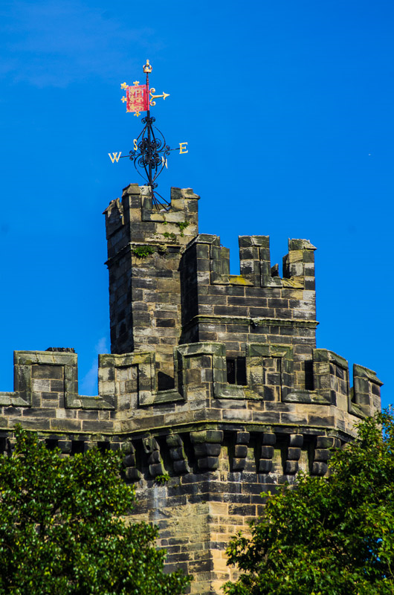
Application process
EBS will nominate you to LUMS Global Experience Team.
Nominated candidates will need to apply via our MoveOn system- you will be sent the link to apply. When applying, you need the following:
  Bachelor’s degree transcript at EBS to date;
  Personal motivation statement – max 2 pages;
  One academic reference;
  Language test certificate (e.g., IELTS);
  High School transcript/diploma
  A scan of your passport’s photo page
Notes:
Transcripts/diplomas must be officially translated and marked as such.

Slide 24
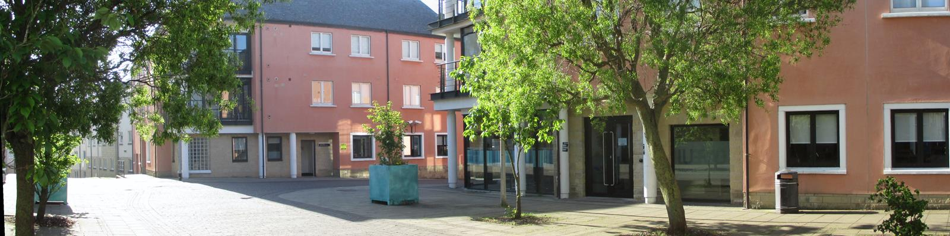
Living costs
Campus accommodation (12 months) 4,800 GB - 5,800 GBP (depending on type)
Food/ subsistence estimate 2,800 GBP
Books, stationery, clothes, local travel, entertainment etc. estimated at 2,000 GBP
More info on living costs available via student and education services:
https://www.lancaster.ac.uk/student-and-education-services/money/budgeting/living-costs/

Slide 25
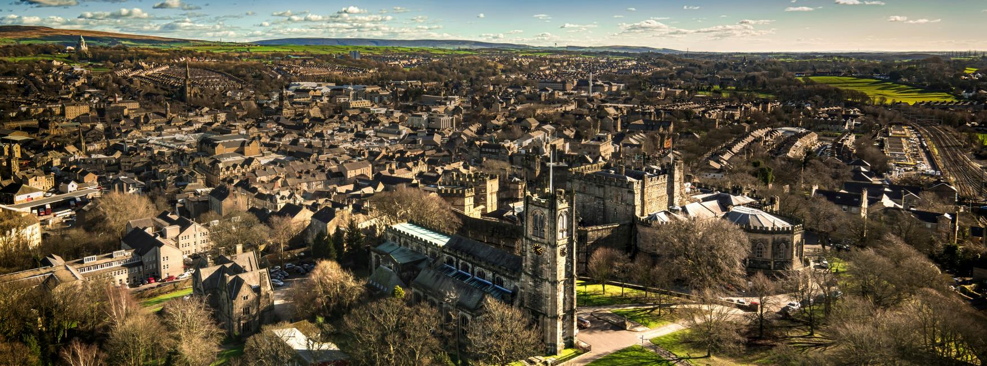

Slide 26

Any questions?
Global Experiences & Partnerships Team
exchangelums@lancaster.ac.uk

